Slide 1
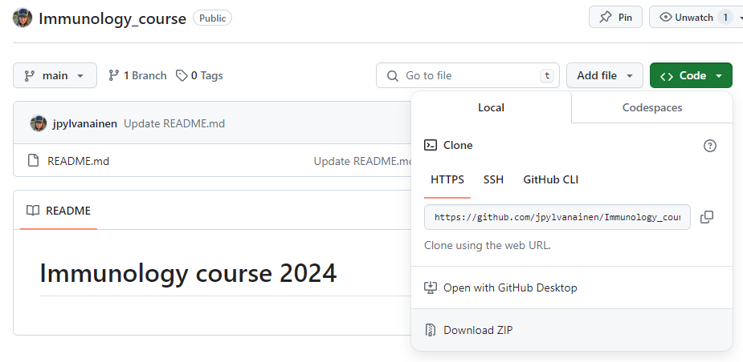
WELCOME! Please install Fiji: https://fiji.sc/
Please download materials from GitHub https://github.com/jpylvanainen/Immunology_course

Slide 2
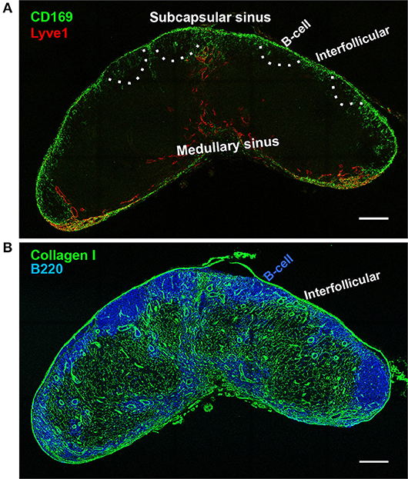
Image analysis in immunology
Localization of immune cells
Cross section of human lymph node
B cells (blue)
Total area
Location
(Louie, D. A. P., & Liao, S. 2019)

Slide 3
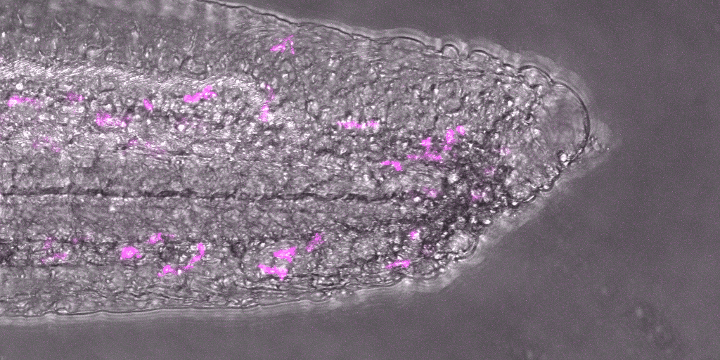
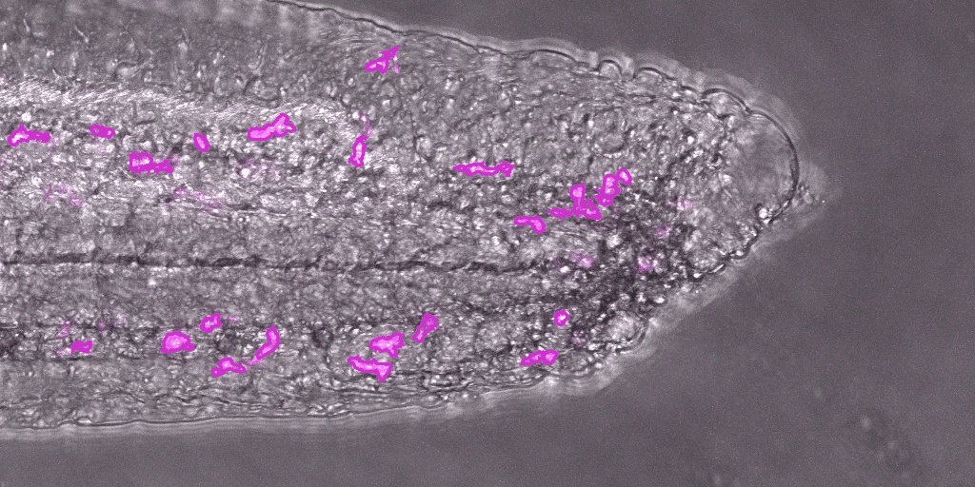

Image analysis in immunology
Immune cell trafficking in zebrafish tail
Immune cells
Ilkka Paatero

Slide 4
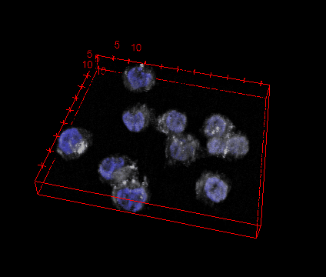
Image analysis in immunology
Protein quantification in immune cells
B-lymphoma cells
phospho-Btk (gray)
Nucleus blue
Images Saara Hämälistö

Slide 5



Image analysis using FIJI Joanna Pylvänäinen joanna.pylvanainen@abo.fi Imaging in immunology course 2024
Pondering cat
Proactive dog
Includes materials from Guillaume Jacquemet, Peter Bankhead, Elnaz Fazeli

Slide 6
Contents
What is FIJI and where to get it
What is an image
How to view your images in Fiji
Look up tables
Channel management (split and merge, channels tool)
Sub-stacks, projections
How to check that your image has the right dimensions
Line measurement
Basic measurements (area, intensity, shape...)
Segmentation basics
ROIs and particle analysis
Binary operations

Slide 7


What is Fiji??
“Fiji is an image processing package — a "batteries-included" distribution of ImageJ, bundling many plugins which facilitate scientific image analysis.”
https://fiji.sc/
Notes:
The main difference between FIJI and ImageJ is that FIJI comes pre-bundled with a number of useful plugins which would require separate download and installation in ImageJ. FIJI also has an auto-update function that ImageJ does not have, and for advanced users is more user friendly and compatible for Macro writing.

Slide 8

Check settings and install more Fiji Plugins
ImageJ was setup to analyse dark particles on white background, still causing issues during workflows. Most analysis these days is of fluorescent particles/organelles on black background. iJ needs to know whether to aggregate bright or dark pixels for particle detection!
Process... › binary... › options › “black background”
To enable additional Plugins, choose
Help › Update…, then click the “Manage update sites” button.
Please activate the following update sites
MorpholibJ
3D image suite

Slide 9
Common steps in image analysis
Image inspection
Filtering
Image measurements
Segmentation and binary operations
image processing
Image analysis
Extraction of useful information from microscopy images

Slide 10
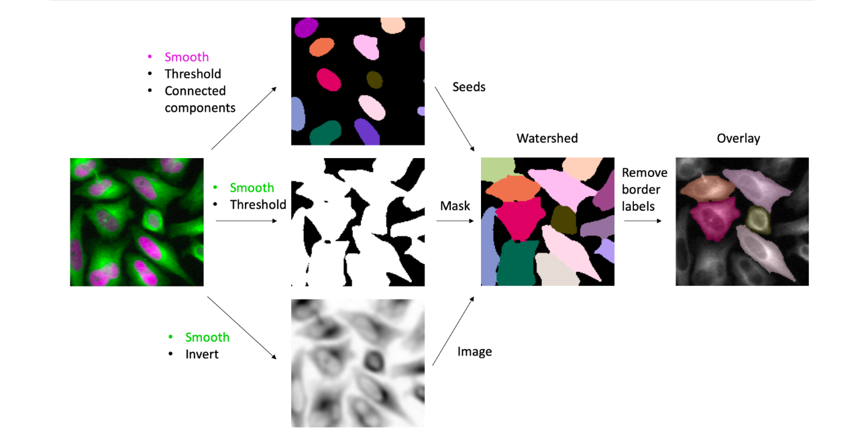
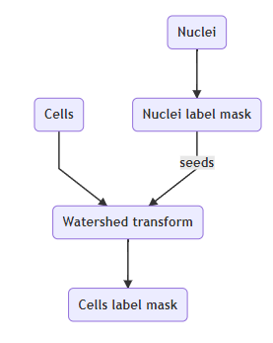
Image analysis pipelines

Slide 11
Common steps in image analysis
Image inspection
Filtering
Image measurements
Segmentation and binary operations
image processing
Image analysis
Extraction of useful information from microscopy images

Slide 12
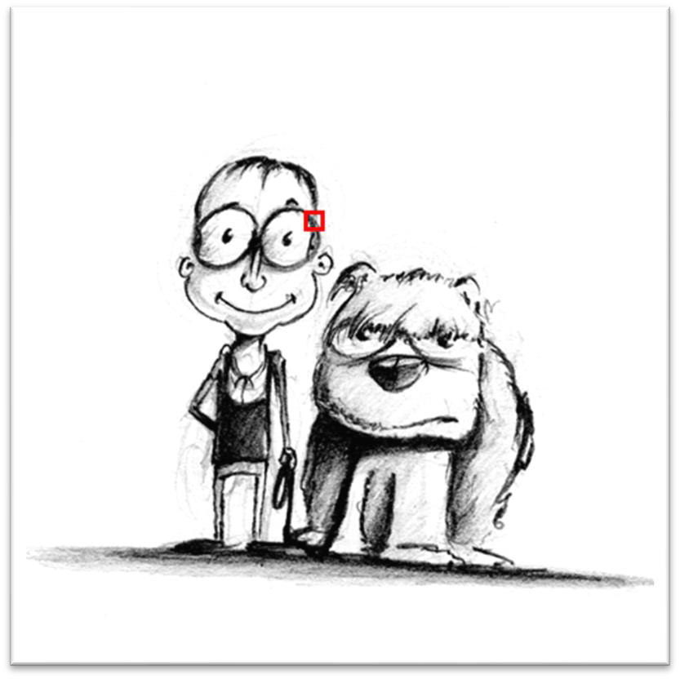
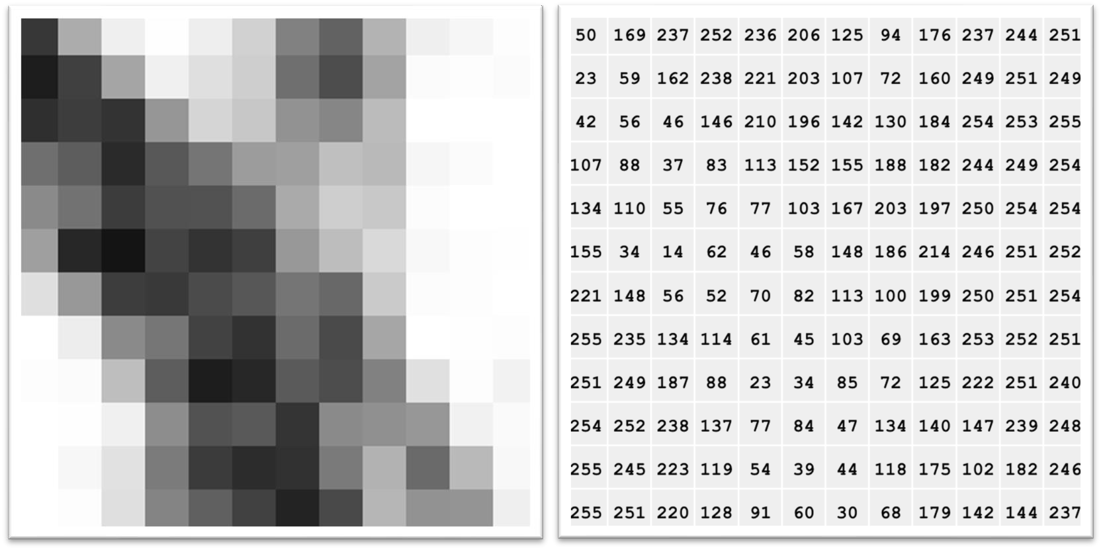
What is an image?
Original image
Enlarged image
Pixel values from 1-256
Introduction to bioimage analysis by Peter Bankhead
https://bioimagebook.github.io/ CC BY 4.0

Slide 13
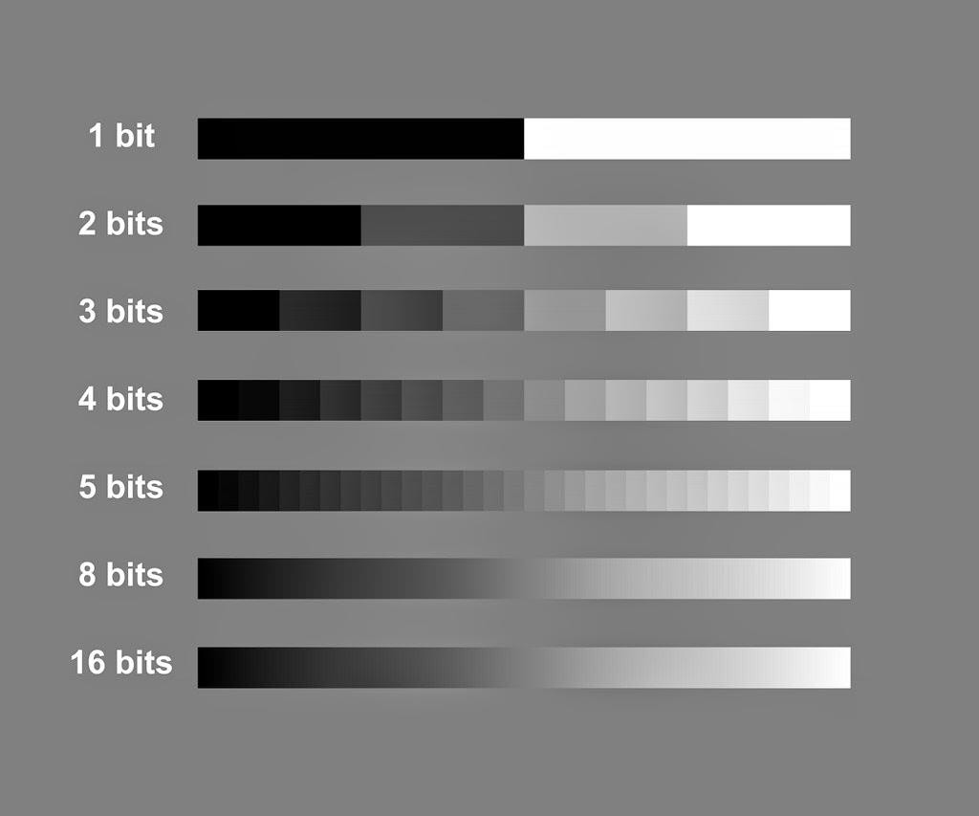
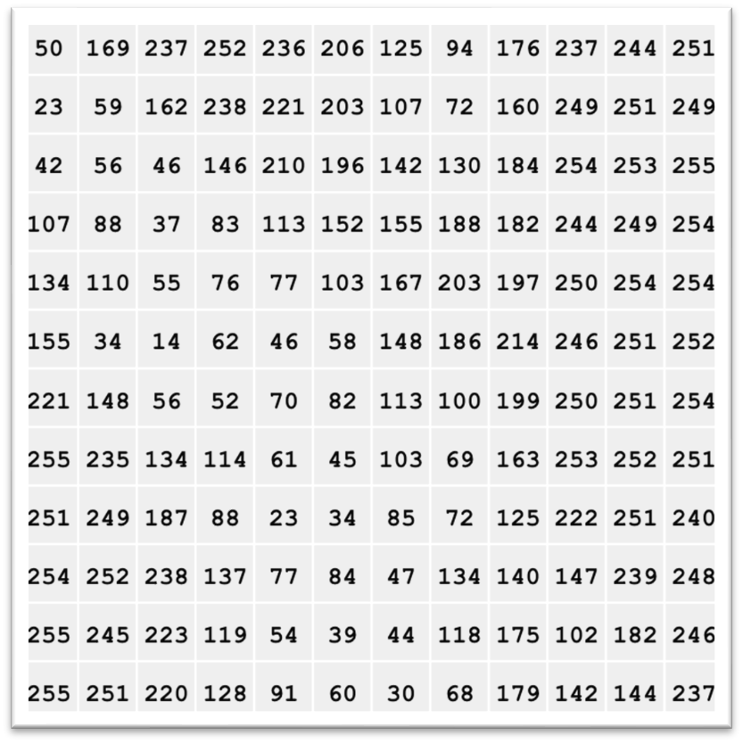
Bit depth
2
4
8
16
25
256
65536
Values from 1-256
Introduction to bioimage analysis by Peter Bankhead
https://bioimagebook.github.io/ CC BY 4.0

Slide 14
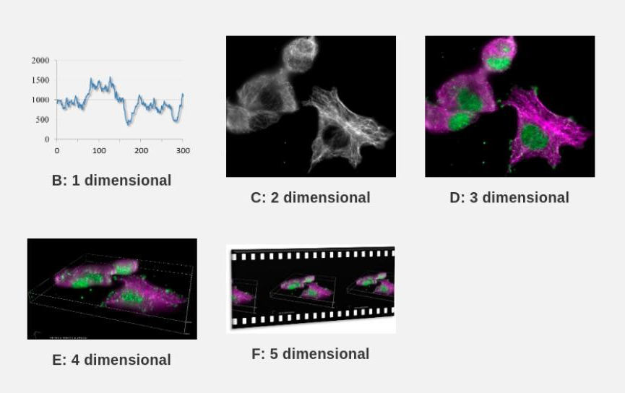
Image dimensionality
Introduction to bioimage analysis by Peter Bankhead
https://bioimagebook.github.io/ CC BY 4.0

Slide 15
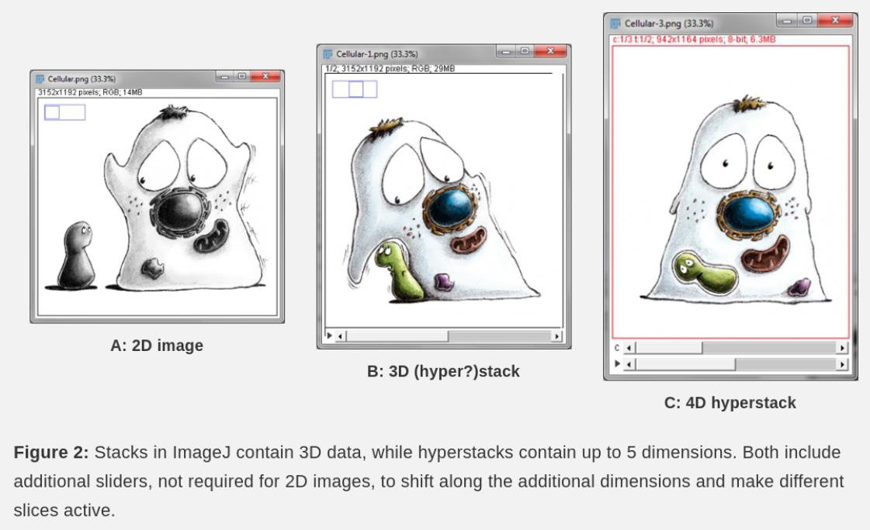
Image dimensionality
Introduction to bioimage analysis by Peter Bankhead
https://bioimagebook.github.io/ CC BY 4.0

Slide 16
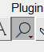
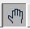
Open image and inspect
Open Fiji + image: Image1-composite-calibrated.tif
Pixels and bit depth, channels?
Zoom mouse right click + mouse left click –
Move around zoomed image use the hand tool
Adjust the contrast Image › Adjust › Brightness/Contrast
Channel management Image › Color › Channels Tool...
Split channels Image › Color › Split channels
Sync windows Analyze › Tools › Sync Windows

Slide 17
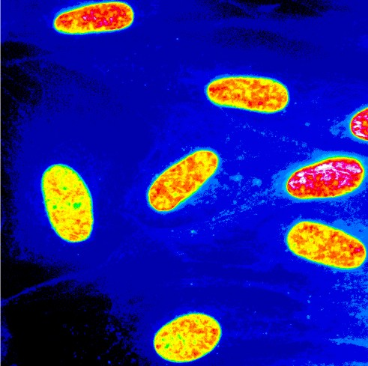
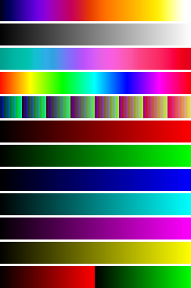
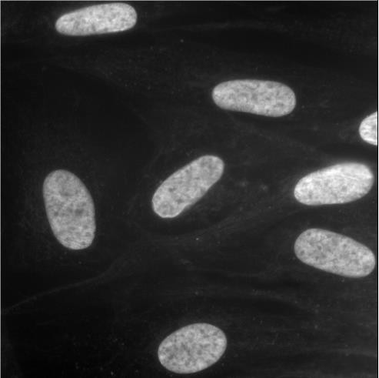
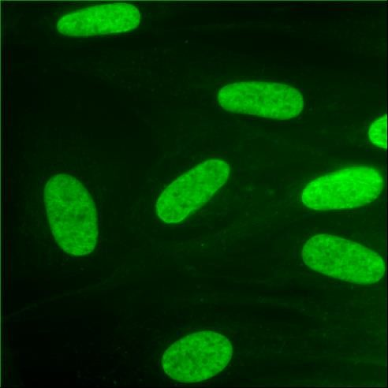
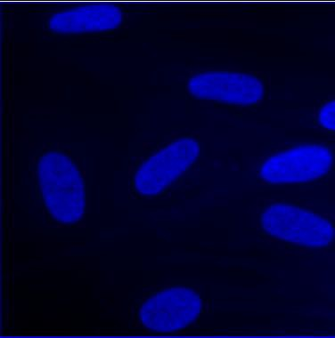
Look up tables (LUTs)
1 256
Try different LUTs Image -> Lookup tables

Slide 18
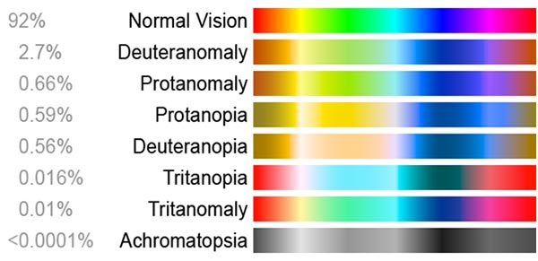
Channel merging
Merge channel
Image › Color › Merge channels
Futher edit LUTs
Image › Lookup tables
Duplicate: shift + D
Image › Type › RGB Color
Image › Color › Simulate Color Blindness
Color blindness simulation
https://www.lenstore.co.uk/eyecare/your-guide-colour-blindness

Slide 19

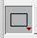
N-dimensional images
Open sample image
File › Open Samples › Mitosis (5D stack)
OR Image7- mitosis
View different channels
Image › Color › Channels Tool...
Make a subset
Image › Duplicate... OR Ctrl + D and select wanted frames, channels, planes
Final image
Isolate one z-plane
Image › Duplicate... OR Ctrl + D
Make z-projection
(from original)
Image › Stacks › Z Project...
Crop image Choose rectangle tool:
draw region of interest
Ctrl + D
Original stack

Slide 20
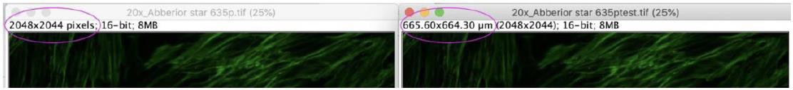
Image calibration
It is important that the image file is handled properly, and the size of the image calibrated, ImageJ doesn’t always read the files properly.
You can see if your image is calibrated from the from the info bar at the top of the image.

Slide 21
Image calibration
Open image: Image1-composite-calibrated.tif
Check image properties
Image -> Properties
Check that the number of channels, slices and frames match
Check your unit of length and set it to μm (um or micron) or nm
Check your pixel width and height (2D images the voxel depth can be ignored)

Slide 22
Common steps in image analysis
Image inspection
Filtering
Image measurements
Segmentation and binary operations
image processing
Image analysis
Extraction of useful information from microscopy images

Slide 23
Image filtering
Filtering can make segmentation much easier by enhancing features and reducing noise
Linear filters replace each pixel by a weighted sum of surrounding pixels: (Gaussian, Mean)
Nonlinear filters replace each pixel with the result of another computation using surrounding pixels (Median)
Linear filter demo
Noise reduction
Correct uneven illumination / Background removal

Slide 24

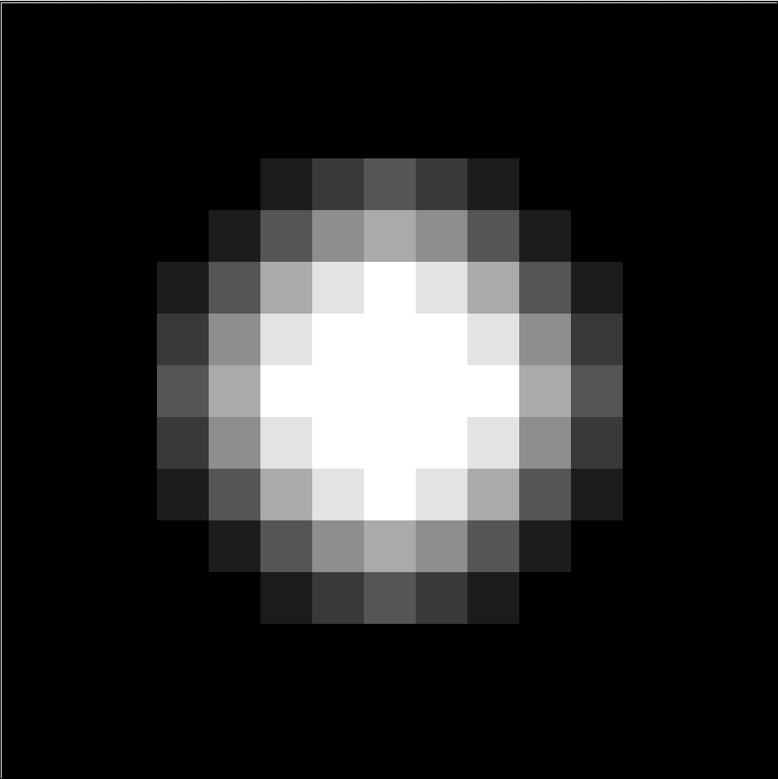
Linear filter demo
1
1
1
Open Image13-blob.tif
Go to Process > Filters > Convolve..
1
1
1
1
1
1
Sobel edge filter
Laplacian of Gaussian (LOG)
1
2
1
1
1
1
0
0
0
1
-8
1
-1
-2
-1
1
1
1
https://imagej.nih.gov/ij/docs/menus/process.html

Slide 25
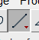
Noise reduction
Open image: Image3-nuclei_noisy
Duplicate your image: shift + D
In Fiji: Process › Filters…
Choose a filter to your liking (try more of you want!)
Choose the original image
Choose line tool and draw a line across the desired distance Analyze › Plot Profile
Select your filtered image and go Edit › Selection › Restore selection… And Analyze › Plot Profile

Slide 26
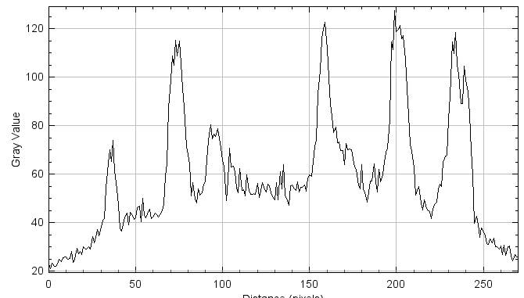
Correct uneven background
Open image: Image4-TH.tif
Duplicate your image: shift + D
Filters: Process > filters…
Method
Choose line tool and draw a line across the desired distance Analyze › Plot Profile
Subtract background using rolling ball Process > Subtract background..
Choose line tool and draw a line across the desired distance Analyze › Plot Profile

Slide 27
Common steps in image analysis
Image inspection
Filtering
Image measurements
Segmentation and binary operations
image processing
Image analysis
Extraction of useful information from microscopy images

Slide 28
Line measurement
To measure a distance in ImageJ, you can use the straight-line tool. Make sure that your image is correctly calibrated first.
Open image Image5-nuclei-high-contrast
Select the straight line tool
Draw a line across the desired distance
Read the length of the line below to ImageJ toolbar. You can also read the last coordinate of the line as well as the angle from the same place. To print the length, press m (measure)
To analyze the line profile Analyze › Plot Profile
Try hitting live button, you can anow move the line
To print the line profile press

Slide 29
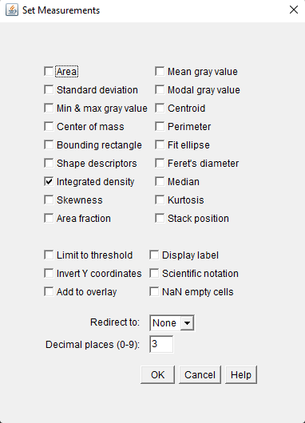
Basic measurements
Select measurements Analyze › Set Measurements...
Size - area, centroid, perimeter, Feret & “shape descriptors” (Circularity, Aspect Ratio, Roundness, Solidity)
Content - (gray values): mean, stdDev, minMax, mode…

Slide 30
Intensity measurements
Set the following measurements: Analyze › Set Measurements...
- Area
- Shape descriptors
- Mean gray value
Open images: Image5-nuclei-high-contrast and Image6-nuclei-low-contrast
Select images and measure one by one Analyze › Measure (or ctrlM)
What can you say about the results?

Slide 31
Common steps in image analysis
Image inspection
Filtering
Image measurements
Segmentation and binary operations
image processing
Image analysis
Extraction of useful information from microscopy images

Slide 32
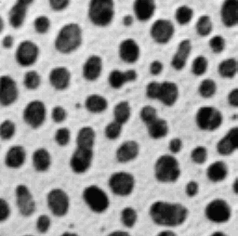


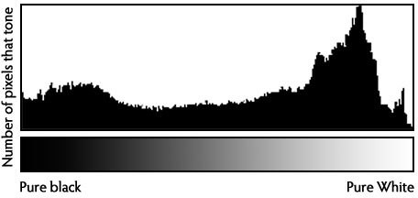
Segmentation
Image segmentation is the classification of pzixels in an image as “pixels of interest” vs “background”
Separating a digital image into multiple segments.
Histogram based thresholding is the most common method to segment.
-> results in a binarized image
background
foreground
histogram

Slide 33
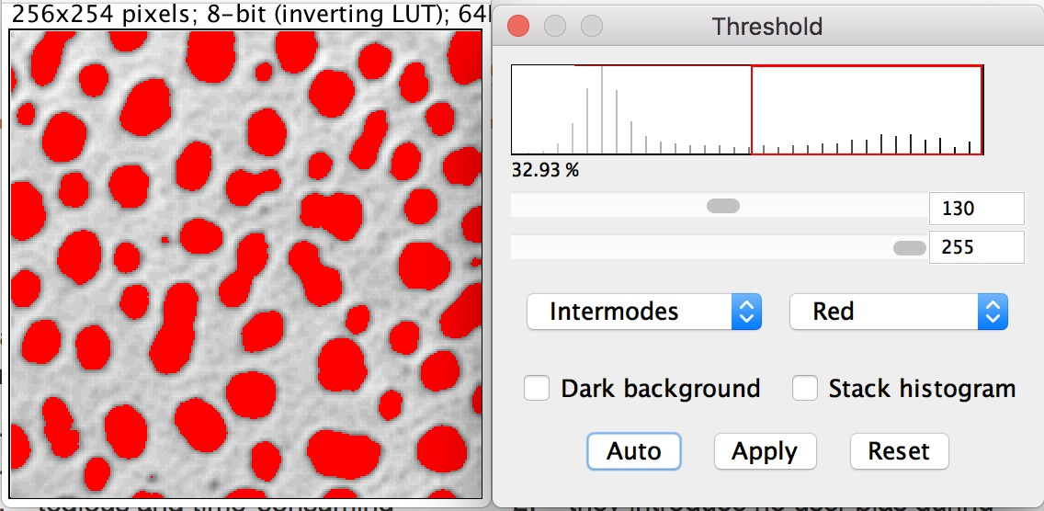
Manual thresholding vs. auto-thresholding
histogram
Manual methods have several limitations:
Benefits of Automated Segmentation
high user bias
no/low reproducibility
tedious and time-consuming fiddling-around
finding an "appropriate" cut-off value
incompatibility with automatic processing
high intra- and inter-user variability
no user bias during thresholding (algorithm selection bias?)
fully reproducible (on the same image they will always
lead to the same binarization result)
objectively determined cut-off values to minimize some variability in images being compared
they are fast (no fiddling) and can be automated

Slide 34
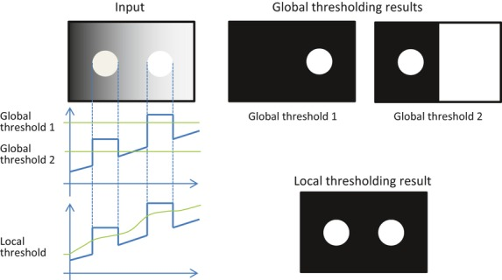
Global / local thresholding
Global thresholding
Chooses a general cut-off value for the whole image
Works well if all portions of the image have same quality, signal to noise/background, and all particles/objects have similar signal levels.
Local thresholding
Computed for each pixel according to the image characteristics within a window of radius r around it
Uchida et al. (2013).
CC BY 2.5

Slide 35
Segmentation
Which segmentation should I use? Try!
Open image: Image8-nuclei-high-contrast-crop
Image › Adjust › Threshold…
More information about global thresholding methods http://imagej.net/Auto_Threshold#Available_methods
Apply a threshold on your image: Image › Adjust › Threshold.. Choose your favorite
-> results a binarized image
Notes:
-> results a binarized image

Slide 36
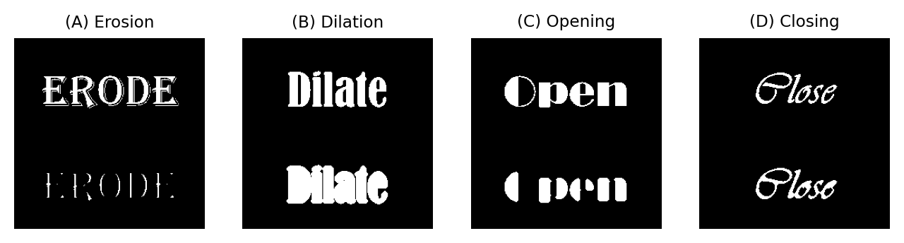
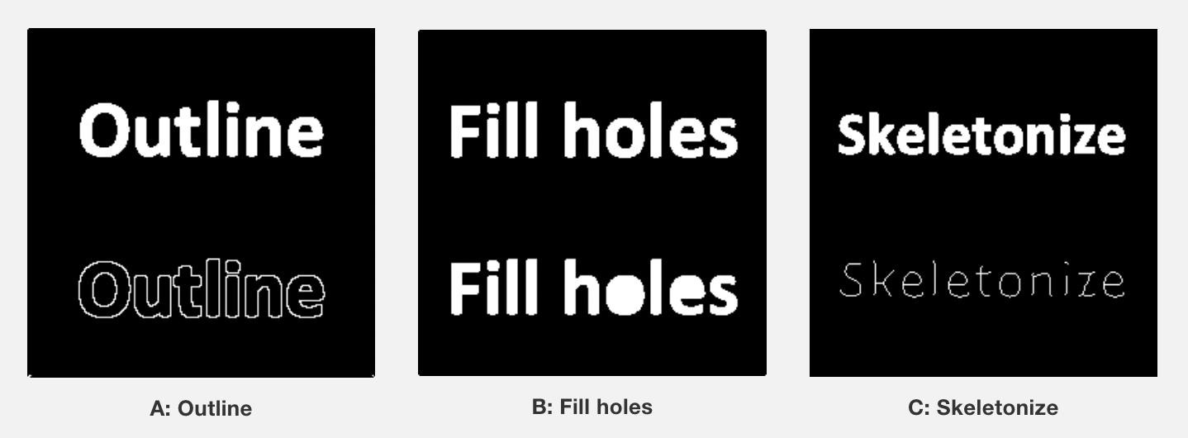

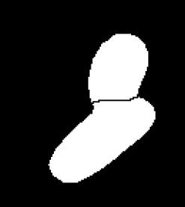
Binary operations
Dilate / Erode / Open / Close
Opening consists of an erosion followed by a dilation.
Closing consists of dilation followed by an erosion
image15_nuclei-low-contrast-binary
Process › Binary › Watershed

Slide 37
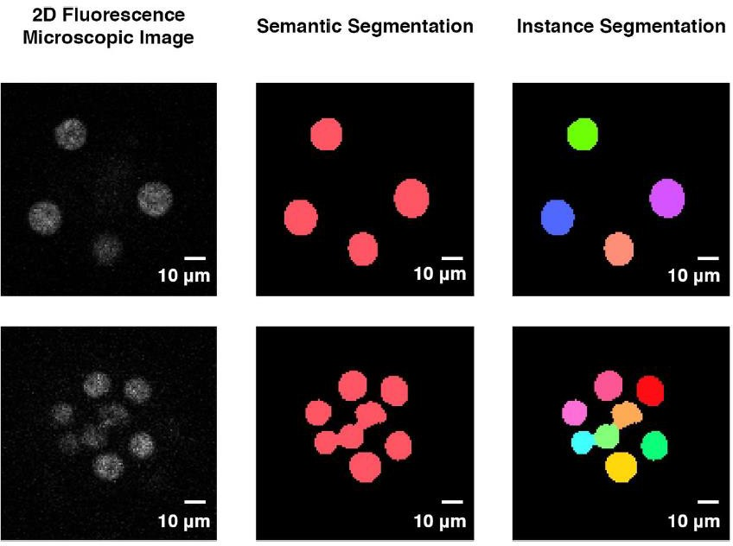
Binary Segmentation
Connected component labeling
Open image image16_nuclei-low-contrast-binary_watershed
Duplicate: shift + D
Plugins › MorphoLibJ › Binary Images › Connected Components Labeling
Learn more about MopholibJ here: https://imagej.net/plugins/morpholibj
0
255
0
255
0, 1, 2, 3……. XX

Slide 38
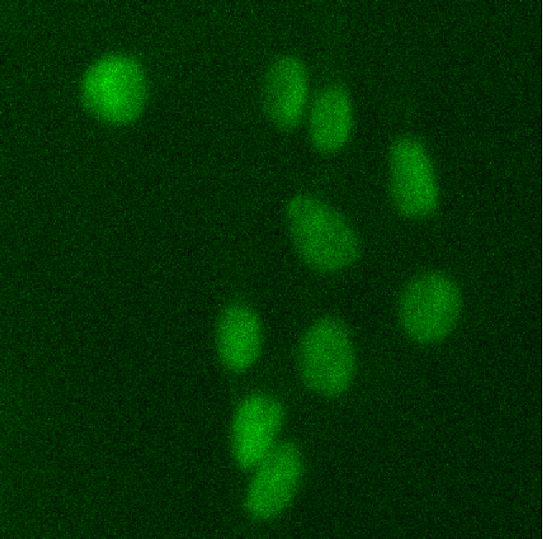
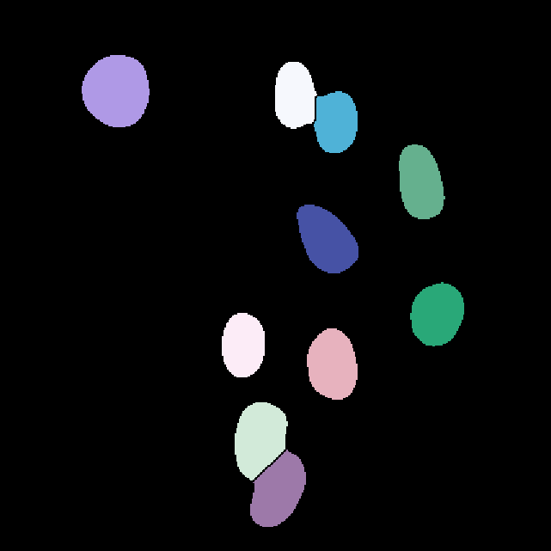
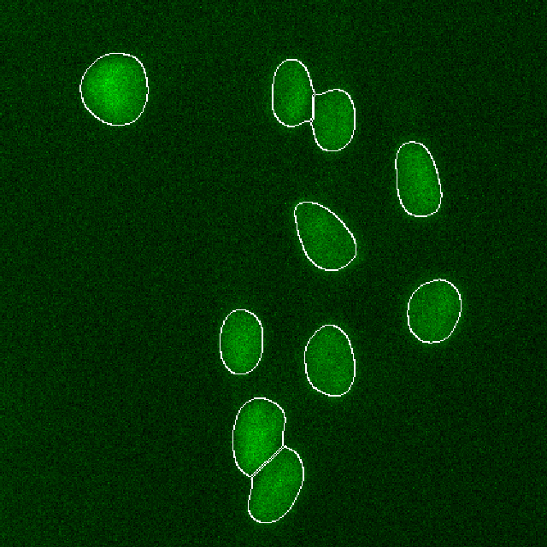
CLIJ demo
Image analysis pipeline

Slide 39
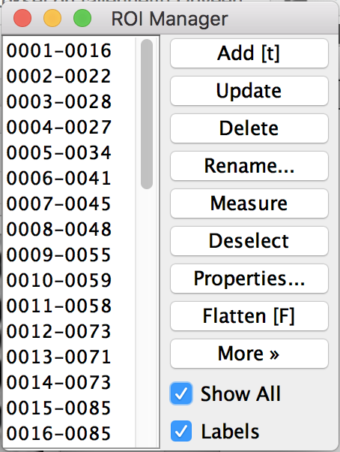
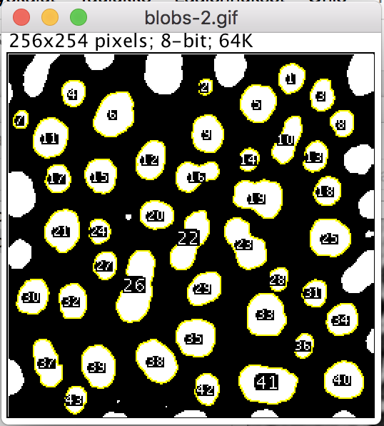
ROIs and particle analysis
Manual selections (=ROIs) are a (slow and biased) way to confine the measurements to organelles/compartments
In ImageJ/FIJI “particle analysis” is a technique to group adjacent pixels in individual ROIs that are
can then measured automatically as individual “objects” (connected component analysis)

Slide 40
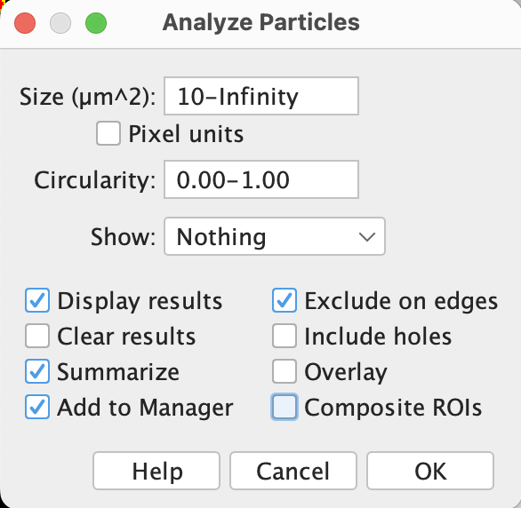
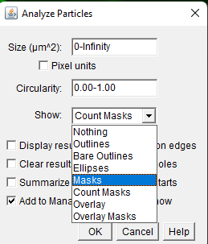
Analyze particles
Open image Image5-nuclei-high-contrast
Dublicate image shift+d
Set the following measurements:
Select your favourite threshold Image › Adjust › Threshold...
Analyze particles Analyze › Analyze Particles...
Analyze › Set Measurements...
Area
Shape descriptors
Mean gray value
Redirect to other channel

Slide 41
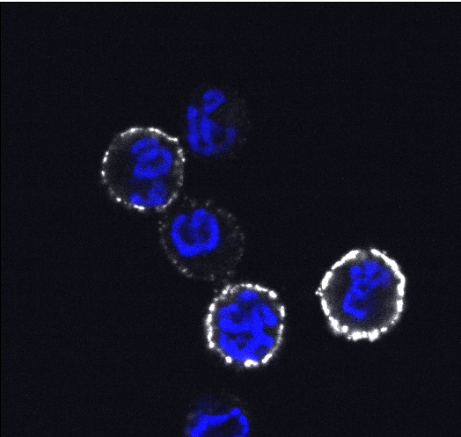
Exercise 1 – 3D analysis
Open images:
Image10-Blymphoma_activated_DAPI_pBtkGrey
Image11-Blymphoma_non_activated_DAPI_pBtkGrey
B-lymphoma cells activated
Activation marker pBtk is higher in activated cells
Images Saara Hämälistö

Slide 42
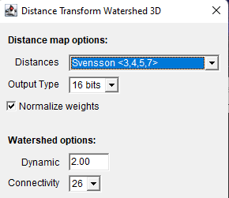
Exercise – 3D analysis
Examine by using brightness and contrast
1. Split channels and duplicate, close blue channel Image › Color › Split Channels
2. Pre-processing (filters)
Median 3D 5/5/5 Process › Filters › Median 3D...
Tophat 10 (don’t subtract) Process › Filters › Top Hat...
3. Detection (Threshold)
Mean, stack histogram Image › Adjust › Threshold...
4. Post-processing (binary)
Fill holes Process › Binary › Fill Holes
5. Post-processing (MorpholibJ)
Distance transform watershed 3D Plugins › MorphoLibJ › Binary Images › Distance Transform Watershed 3D
6. ROI management and measurement
Add image in 3D image suite Plugins › 3DSuite › 3D Manager
Select original image, Select all - quantify

Slide 43
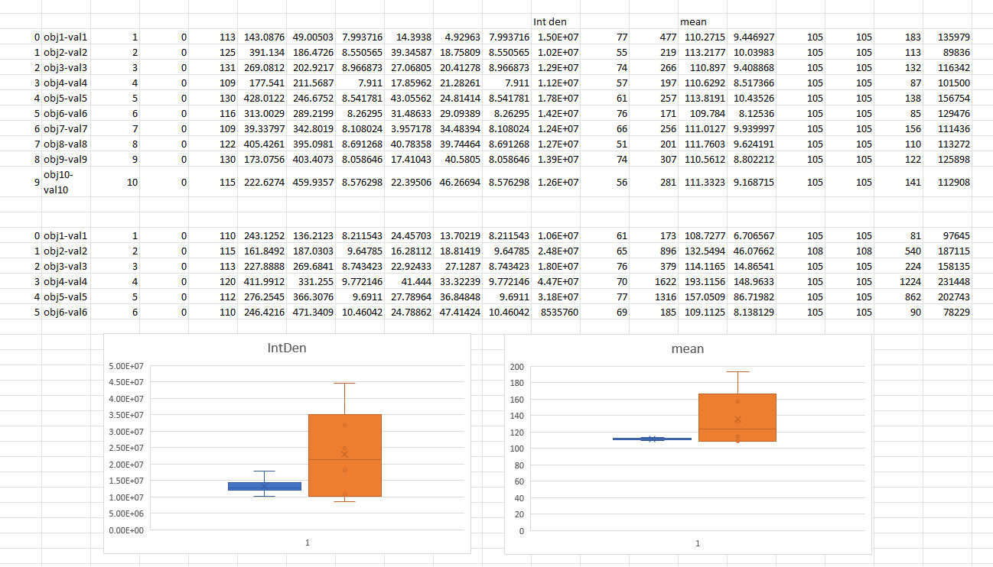

Slide 44


Add scale bar in Fiji
Make sure that your image the unit of length is set to μm Analyze -> Set Scale
Add scale bar Analyze -> Tools -> Scale bar
If you intend to safe the image in tiff or avi format, remember to untick the overlay box. It will create another image layer (so the scale bar can still be removed Image › Overlay › Hide Overlay ).
If savings png or jpeg, you can leave the box ticked, the layer will be merged with the image when exporting.
Note! Remember to do all the other modifications (e.g., merging/adjusting brightness and
contrast/maximum projection) first and add the scale bar to the final image before exporting.

Slide 45
Image saving
Lossless compression ​algorithms reduce file size while preserving a perfect copy of the original uncompressed image. Lossless compression usually, results in larger files than lossy compression. (PNG, TIFF, GIF)
For what purpose you are saving the image?
Backup – don’t edit image!
Processing and analysis – work with the copy of the original image
For power point presentations
Power point slide resolution is on default 1280 x 720
Your image is a fraction of this – smaller images are just fine
For visualization / publication figures
Plan your figure first, saves time
Use high resolution 300dpi
What software will you use? Most do not support 16-bit
Note!​ If you have already saved your images in a lossy format, there it is not possible to gain back the lost information. Therefore, always remember to hold on to your original image so that you always have a way to start over. It in generally recommended to work in a copy of an original image.
Lossy compression​ algorithms preserve a representation of the original uncompressed image that may appear to be a perfect copy, but it is not. Often lossy compression results in smaller file sizes than lossless compression. (JPG/JPEG)

Slide 46

Weka segmentation
File › Open Samples › Blobs
Plugins › Segmentation › Trainable Weka Segmentation
Create result – segment Analyze particles

Slide 47
https://elmi.embl.org/wp-content/uploads/2019/07/ELMI_Brno_ViborLaketa.pdf

Slide 48

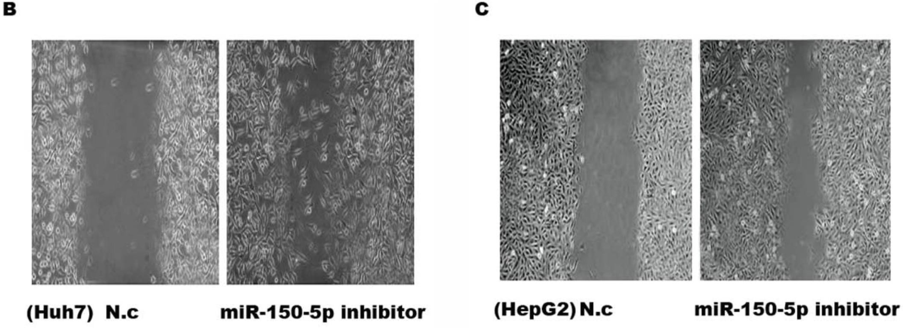
Don’t try your luck

Slide 49
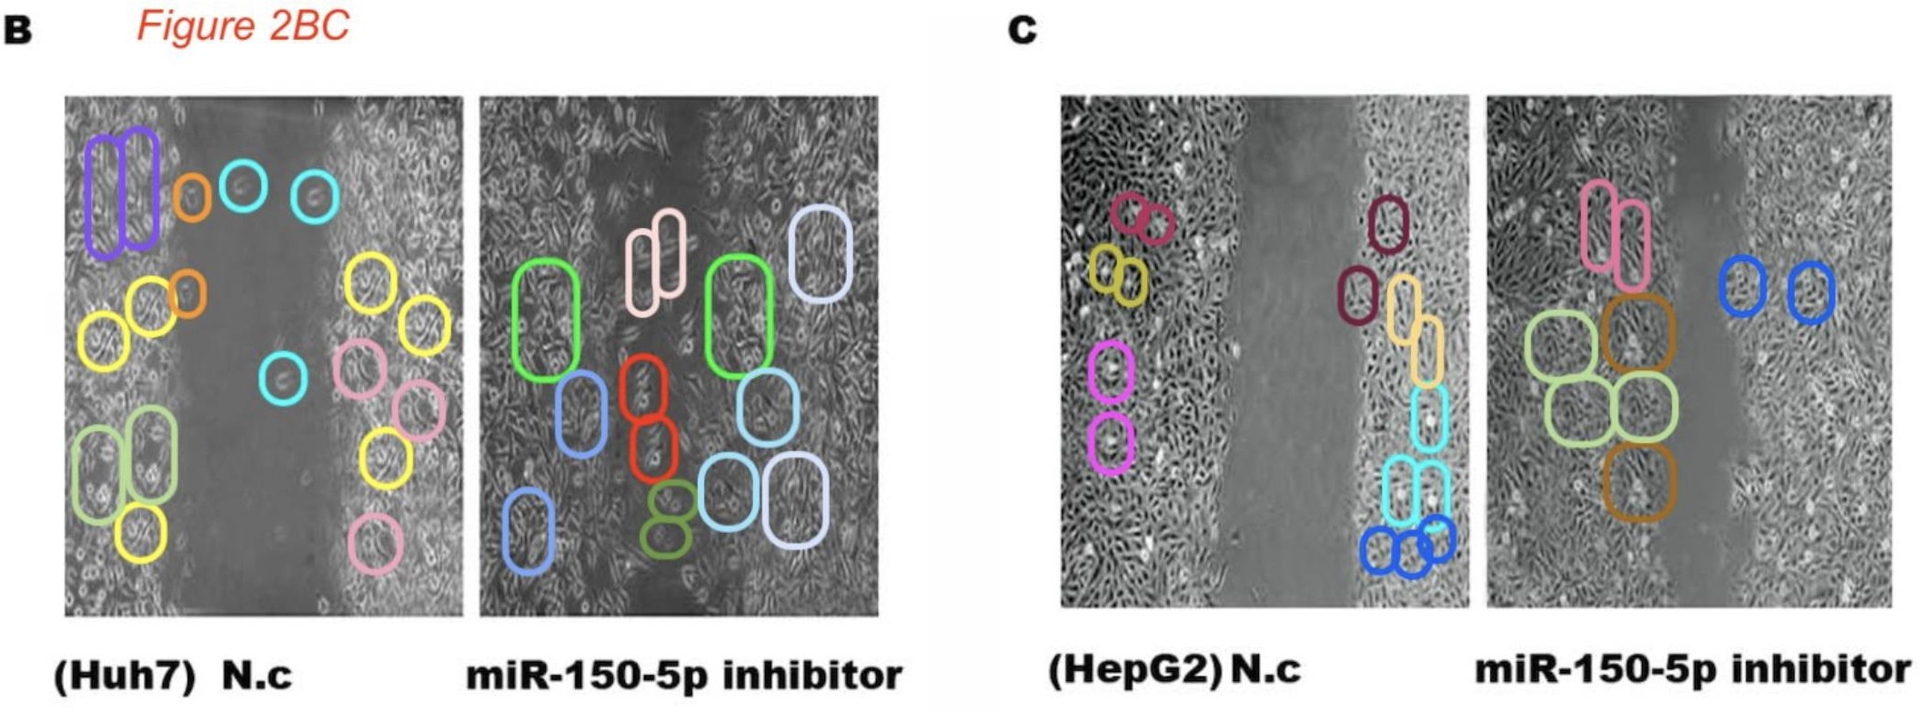
Don’t try your luck

Slide 50
Difficult thresholding
Open image Image6-nuclei-low-contrast
Try to segment nuclei
5 min -> GO! Your solution?

Slide 51

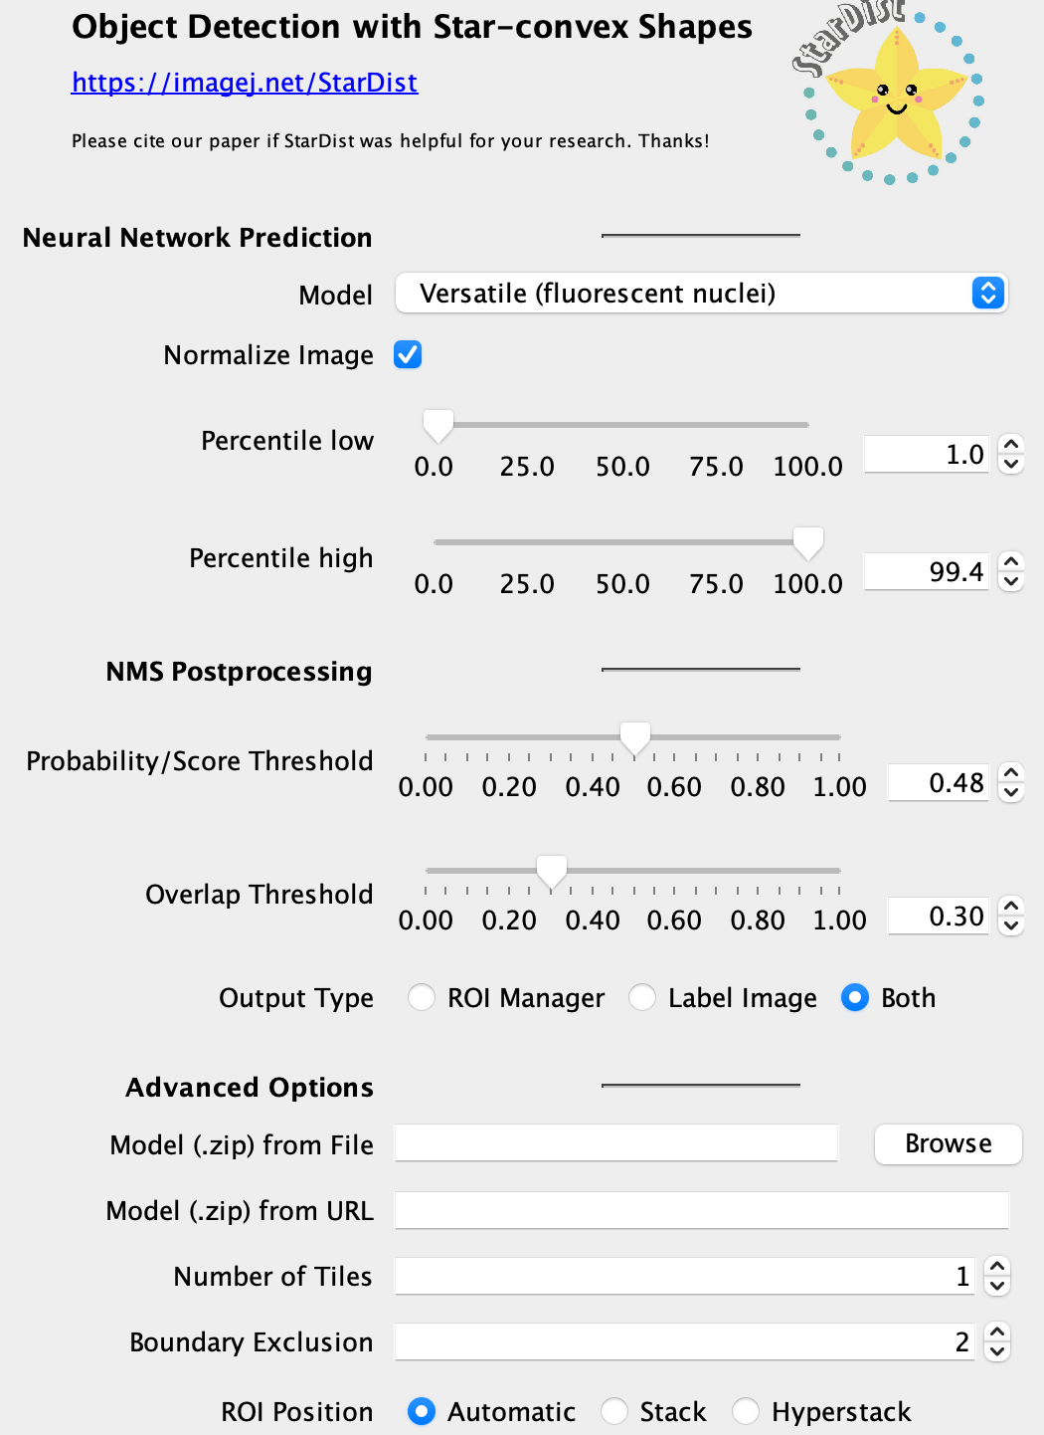
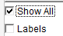
StarDist segmentation
Open image: Image6-nuclei-low-contrast
Run StarDist Plugins › StarDist › StarDist 2D
Load default setting from the bottom of the UI
Output type -> both
OK
Apply the ROIs to your original image
Set measurements
Measure
In results table, try different distributions
Results > distribution…

Slide 52
Feature enhancement
Open image: Image5-nuclei-high-contrast.tif
How would you highlight the nuclei edges? What is special in that region?
Filters: Process > Filters > Variance
What would make the edge enhancement better?
Notes:
Variance filter it computes the variance among the neighboring pixel and assign the variance to the “result pixel”

Slide 53
Viewing 3D images using 3D viewer
Open sample image Image14_PC3_stack
Do any adjustments and merging needed first (split, merge, adjust brightness…)
When your image is looking good, go to 3d-viewer: Plugins -> 3D viewer
Choose suitable settings for your purpose and click Ok.
Show coordinates or surrounding box: Edit -> Show… Make sure that Show contents is ticked. This shows your image.
Practice a little how the viewer responses to mouse movements.
You can take a snapshot of the view: View -> Take snapshot
When you are ready to do recording go to View -> Start Freehand Recording
Move the image to your preference.
When ready go to View -> Stop Freehand Recording
You can now play the movie in a new window (first rendering is slow).
Exporting: File -> Save as -> AVI…
Choose compression (PGN is generally good for online publishing) and frame speed (24 fps the universally accepted film frame rate).
Choose saving location and you’re done!

Slide 54
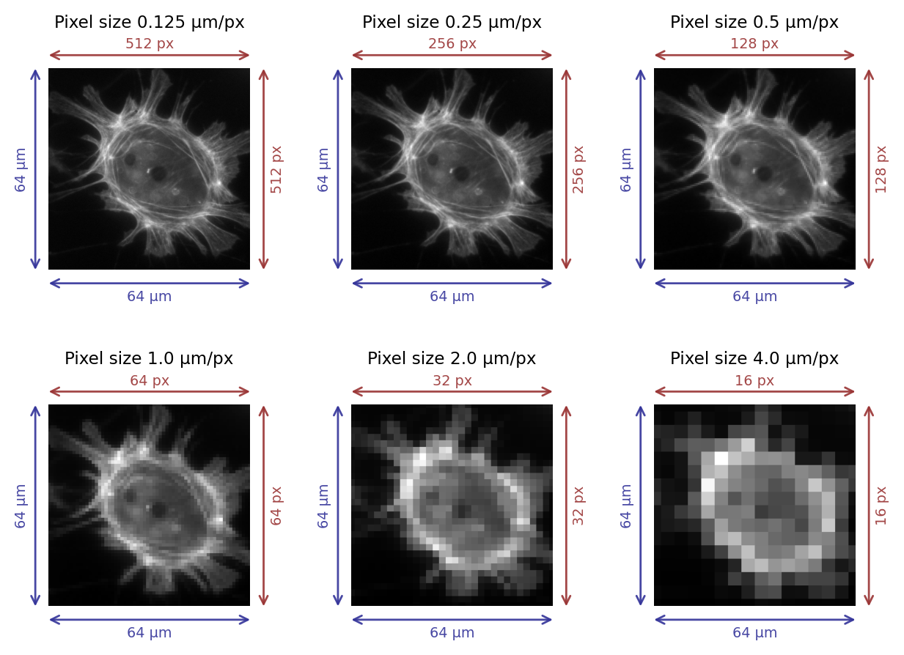
Pixel size counts
Why do we care about pixel size?
What if one pixel = 1 μm?
Introduction to bioimage analysis by Peter Bankhead
https://bioimagebook.github.io/ CC BY 4.0

